Slide 1

SentimentNet: Mood-based Music Generation using ML

Slide 2
Situation and Project Goals
Situation:
Compose new music given a sentiment and a theme song.
Goals:
Analyze the music based on the audio and performance level parameters.
Generate multiple alternatives to the original music for the given emotion, keeping the underlining theme intact.

Slide 3
Approach
Created a labelled dataset of significant emotions (happy, sad, and suspenseful) in movie scenes.
Developed a model called SentimentNet that learns music parameters such as patterns (notes), performance score and emotion.
SentimentNet predicts new music sequences.
SentimentNet is evaluated on basis of similarity measures using fuzzy algorithm (Music recommender, 2016), and spectrogram plots.

Slide 4

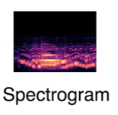
Input and Output
SentimentNet
New music with
required mood
Music file + Mood
4

Slide 5
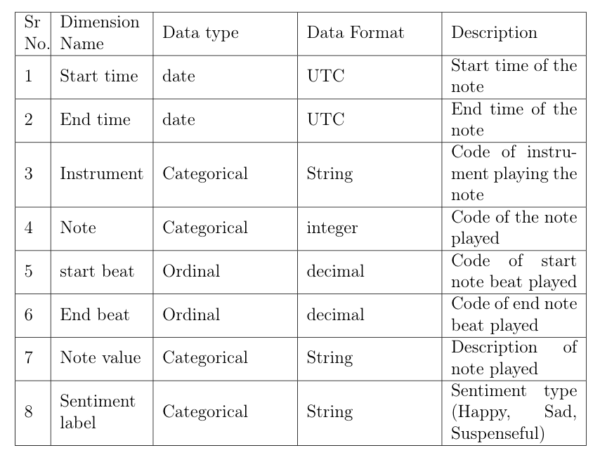
Data

Slide 6
Objectives and Constraints
No low-latency requirement
Interpretability of model
Errors analysis
Output features

Slide 7
Objectives and Constraints
No low-latency requirement
Interpretability of model
Errors analysis
Output features

Slide 8
Libraries
Reading and processing audio files
Music21
Librosa
Intervaltree
Model building
Torch - nn
Sklearn - train_test_split

Slide 9
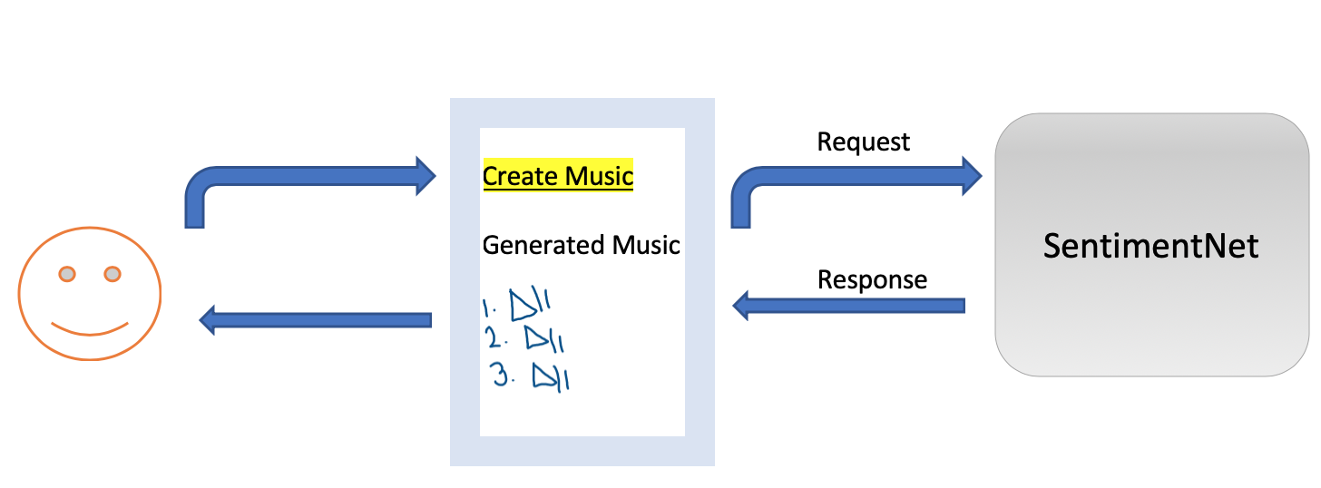
Recommendations
Build an interactive interface for the music composers.

